Slide 1

The Future of Energy
Powering a Sustainable World

Slide 2
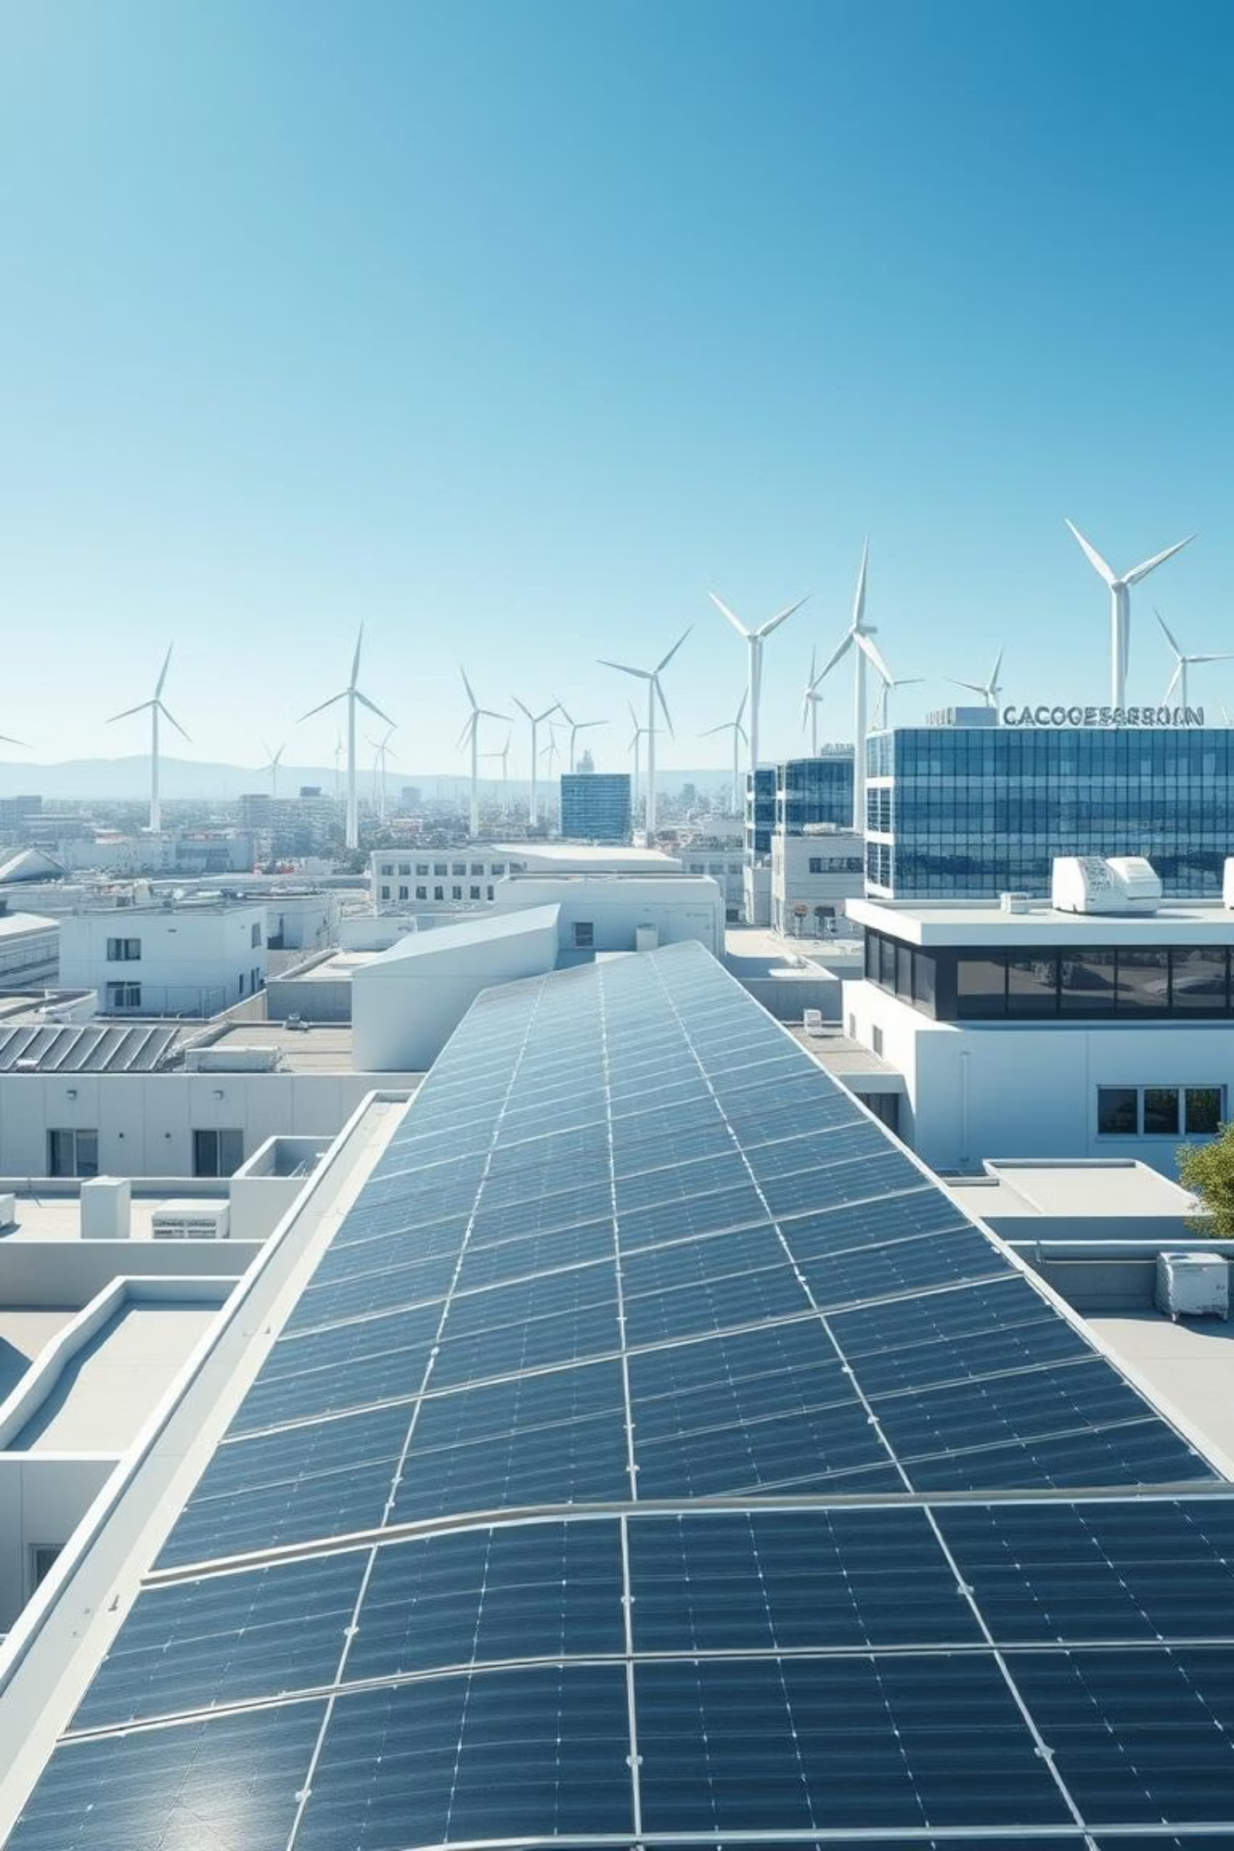
Driving Sustainable Progress
Embracing renewable energy is crucial for a healthier planet and a more secure future. Here's why:
Reduces Carbon Emissions: Transitioning to renewables significantly cuts greenhouse gases, mitigating climate change.
Lowers Energy Costs: Harnessing natural resources leads to long-term savings and stable energy prices.
Supports Energy Independence: Less reliance on finite fossil fuels enhances national security and economic stability.

Slide 3
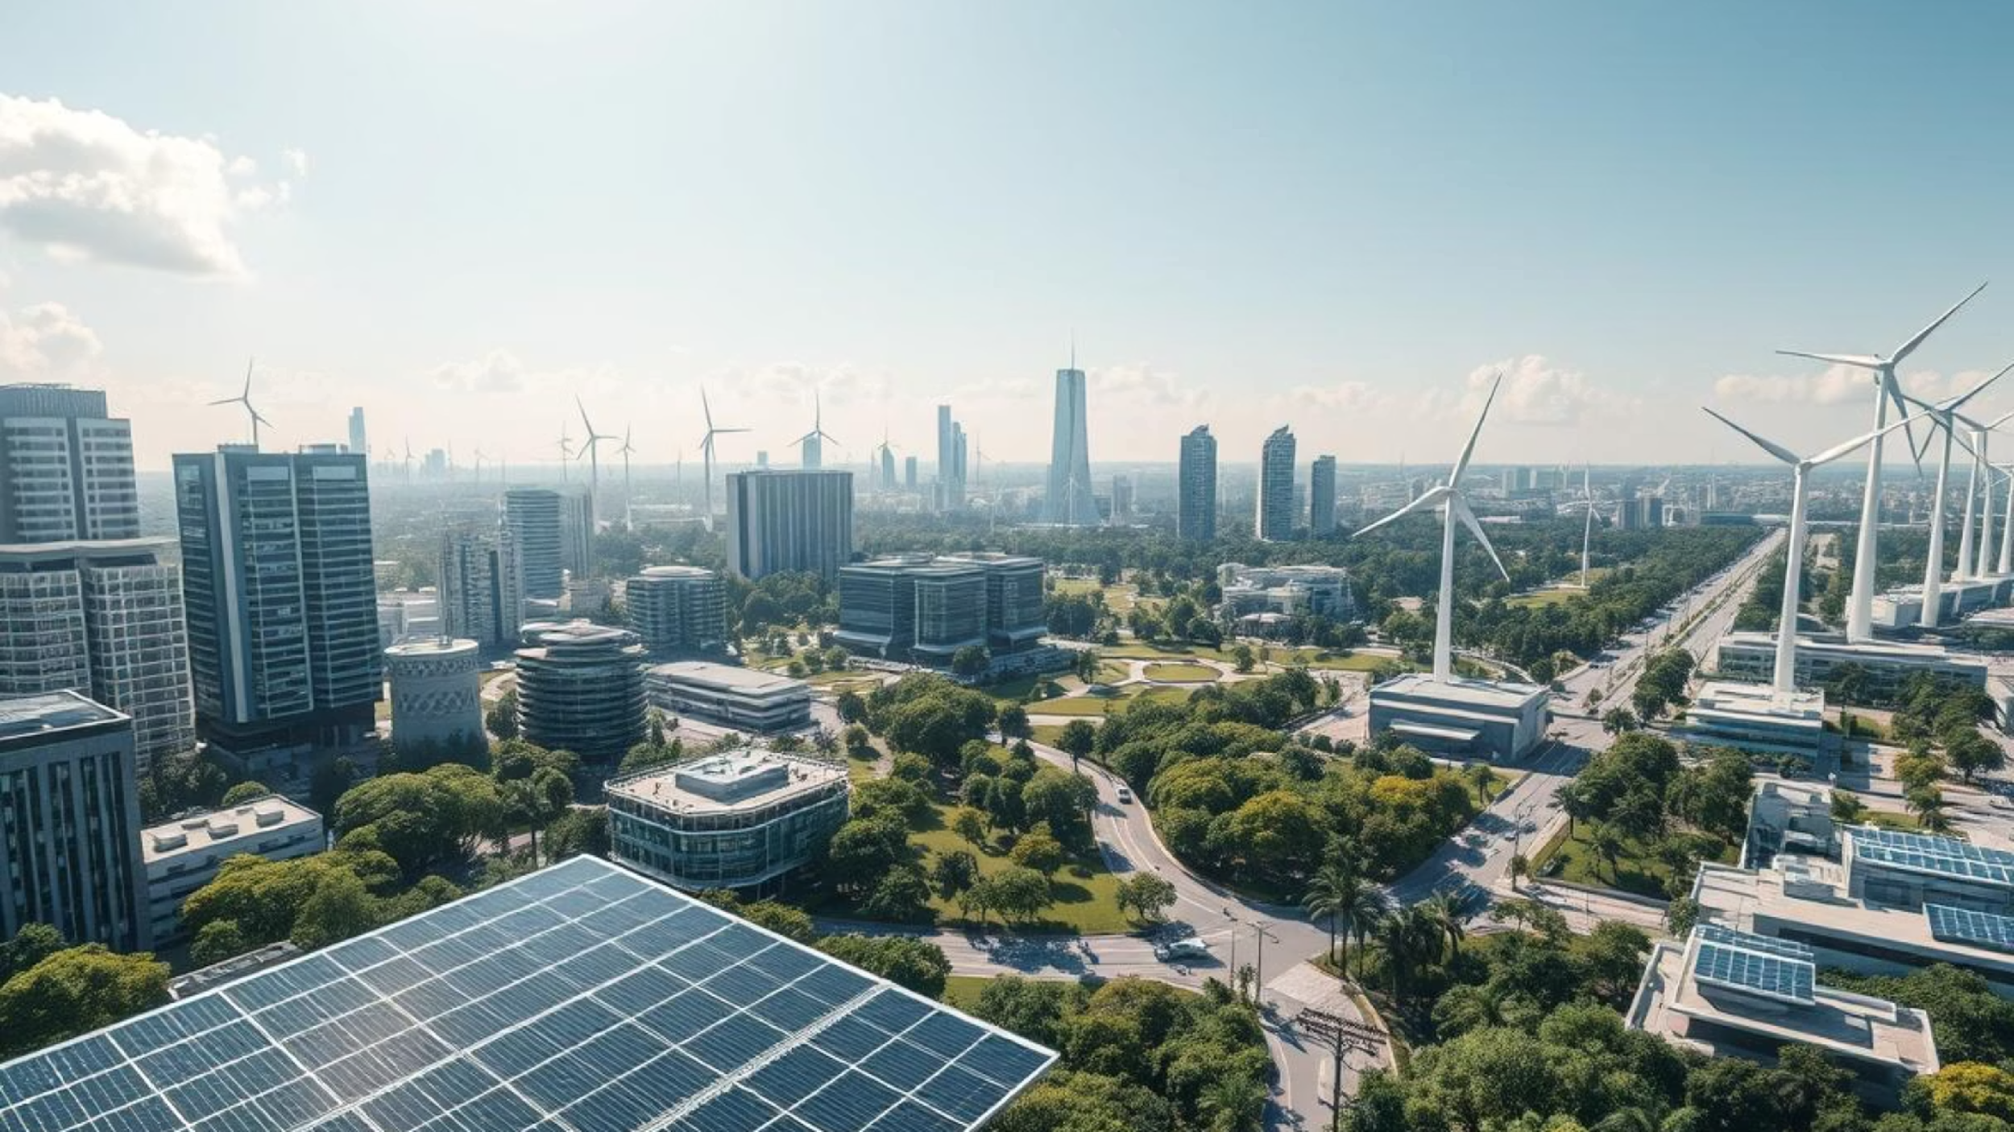

Embrace a Sustainable Future
The journey towards a sustainable energy future is not merely an environmental necessity; it is a profound opportunity for economic growth, enhanced security, and a healthier planet for generations to come. By championing renewable energy, we actively diminish our carbon footprint and ignite innovation, paving the way for a more resilient and vibrant world.
Join the green revolution today and power a sustainable tomorrow!

